Slide 1


ST LoRa Dev Kit
Hands On Session
Julio Merette
Notes:
Key messages: machineQ™ is providing a secure, scalable, cloud-based IoT management platform offering fully integrated gateway and device management, monitoring, and services for solution providers to meet the needs of their business customers.

Slide 2


Agenda
1. machineQ Network Architecture
2. ST LoRa Dev Kit overview
3. mQ Central – Network Management Portal
4. let’s play!!!
COMCAST CONFIDENTIAL
Notes:
Key messages: Our comprehensive IoT platform has all of the pieces including; development kits, connectivity, hardware and device storefront, simplified activation, device management and data visualization software that solution providers need to bring their solution to market. Leave it all to us.

Slide 3
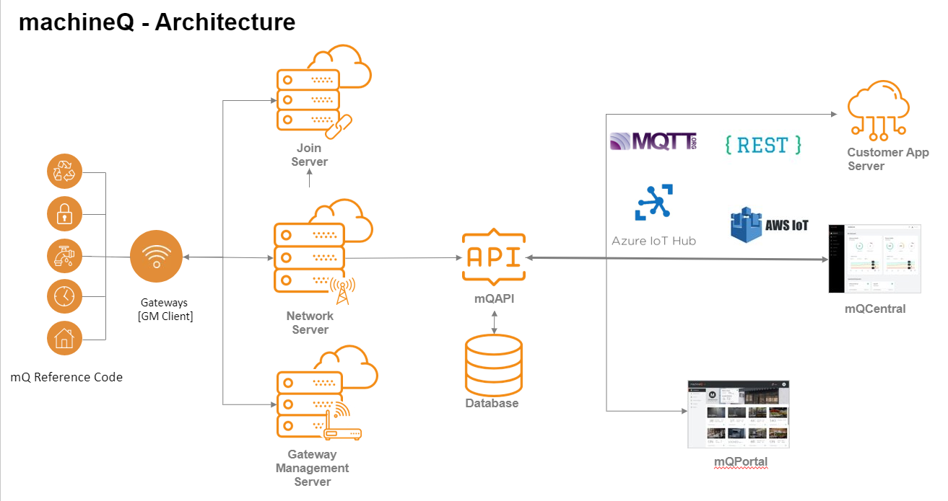

Slide 4
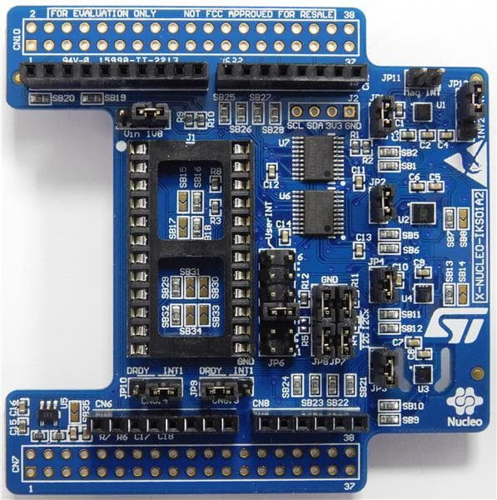
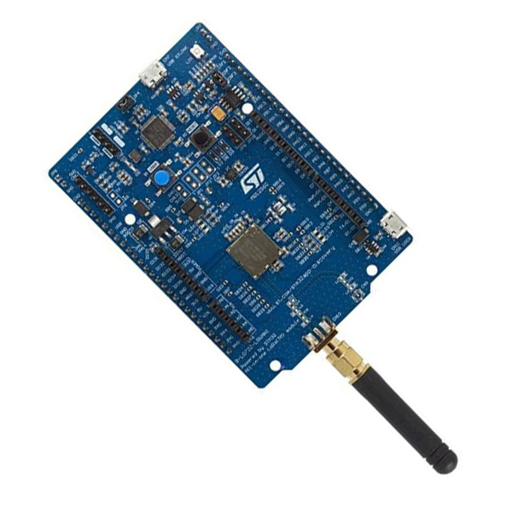
ST LoRa Dev Kit
CMWX1ZZABZ-091 LoRa® module (Murata)
Embedded ultra-low-power STM32L072CZ Series MCUs, based on Arm® Cortex®-M0+ core, with 192 Kbytes of Flash memory, 20 Kbytes of RAM, 20 Kbytes of EEPROM
Frequency range: 860 MHz - 930 MHz
USB 2.0 FS
Embedded SX1276 transceiver
+14 dBm or +20 dBm selectable output power
Board power supply:
Through USB bus or external V_{IN}/3.3 V supply voltage or batteries
7 LEDs
2 push-buttons (user and reset)
Arduino™ Uno V3 connectors
Arm® Mbed™ (see http://mbed.org)
And More…..

Slide 5
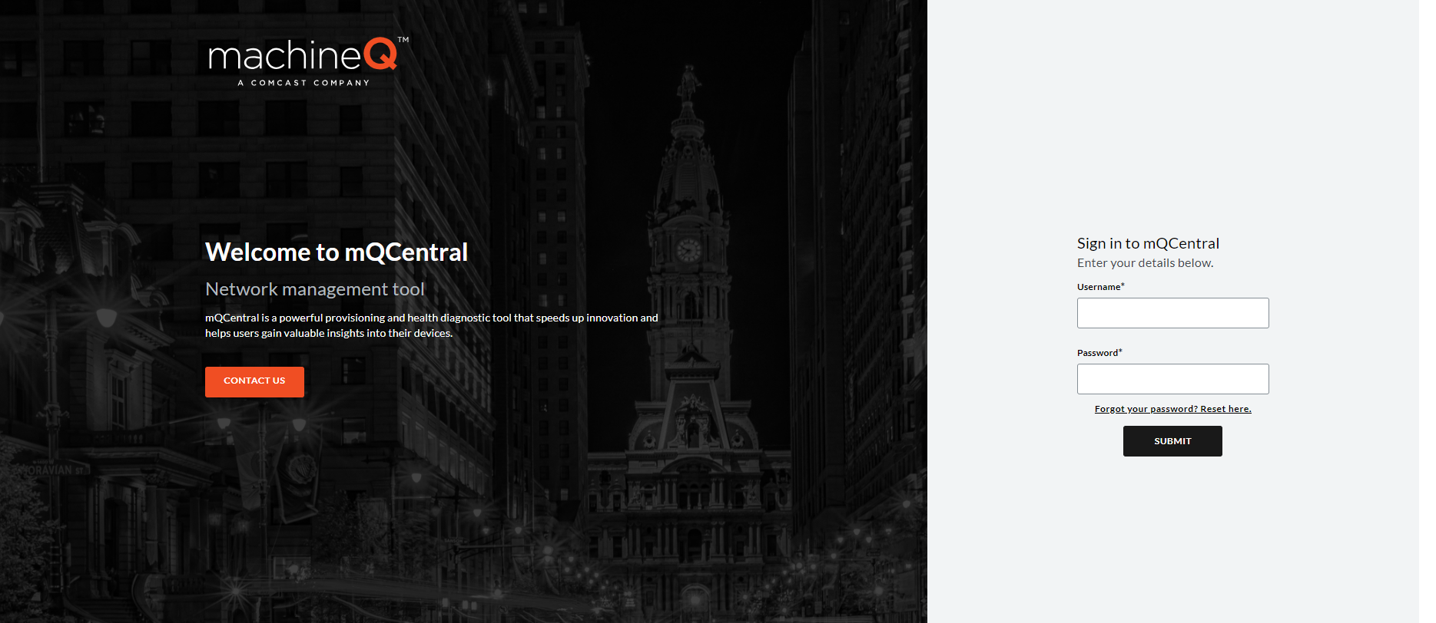

Slide 6

https://github.com/beous/Lora-Bootcamp-machineQ

Slide 7
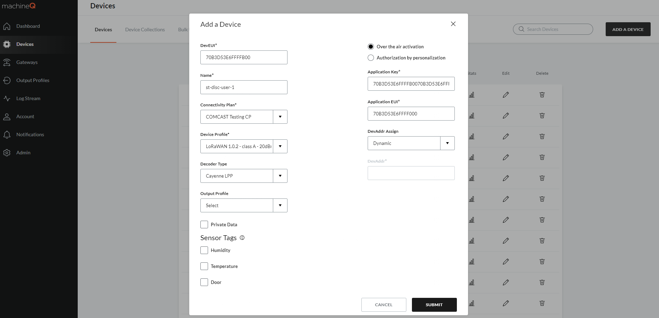
mQ Central Device Configuration
2
1
4
3
Device DevEUI
5
Name
Connectivity Plan:
COMCAST Testing CP
Device Profile:
LoraWAN1.0.2 ClassA 20dBm FCC RX2 SF12
Decoder: Cayenne LPP
6

Slide 8
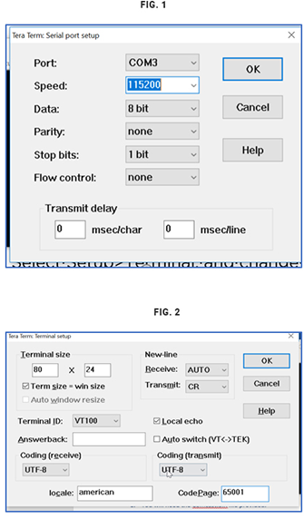
Setting Up the ST LoRa Dev Kit Board
Plug the provided micro-USB into the CN7 USB STLINK port on the ST Discovery board and into your computer.
Download the binary file here.
Open FileExplorer and click This PC. Scroll down to Devices and Drives. The board will appear as a drive.
Drag the binary file into the drive, and wait for the transfer to finish. The LD5 LED light will blink on the board.
Set up TeraTerm (or your terminal of choice):
Launch the application.
Select the Serial radio button and choose your port from the drop-down menu.
Select Setup>Terminal, and change the settings to the those in Fig. 1
Select Setup>Serial Port, and change the Speed (the baud rate) to the those in Fig. B for the appropriate Port.
Press the black RESET button on the board, which should prompt you to enter the credentials from machineQ.

Slide 9
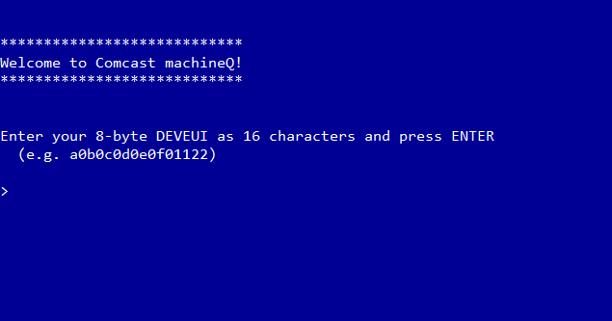

Setting Up the ST LoRa Dev Kit Board
Enter your DevEUI, AppEUI and AppKey
Enter your transmit duty cycle in mS
Reset

Slide 10
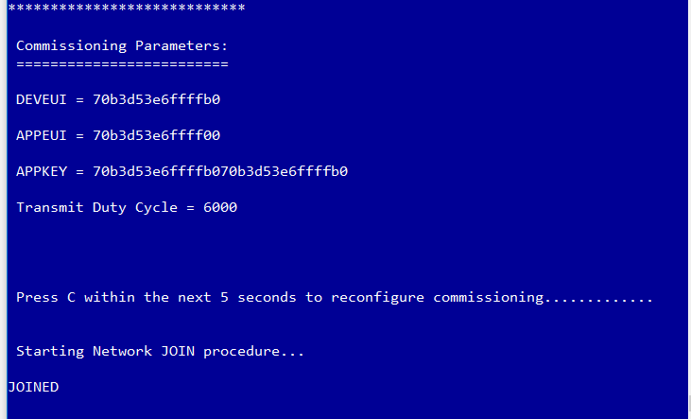
Test
1. Confirm the ST Discovery JOINED the Network

Slide 11
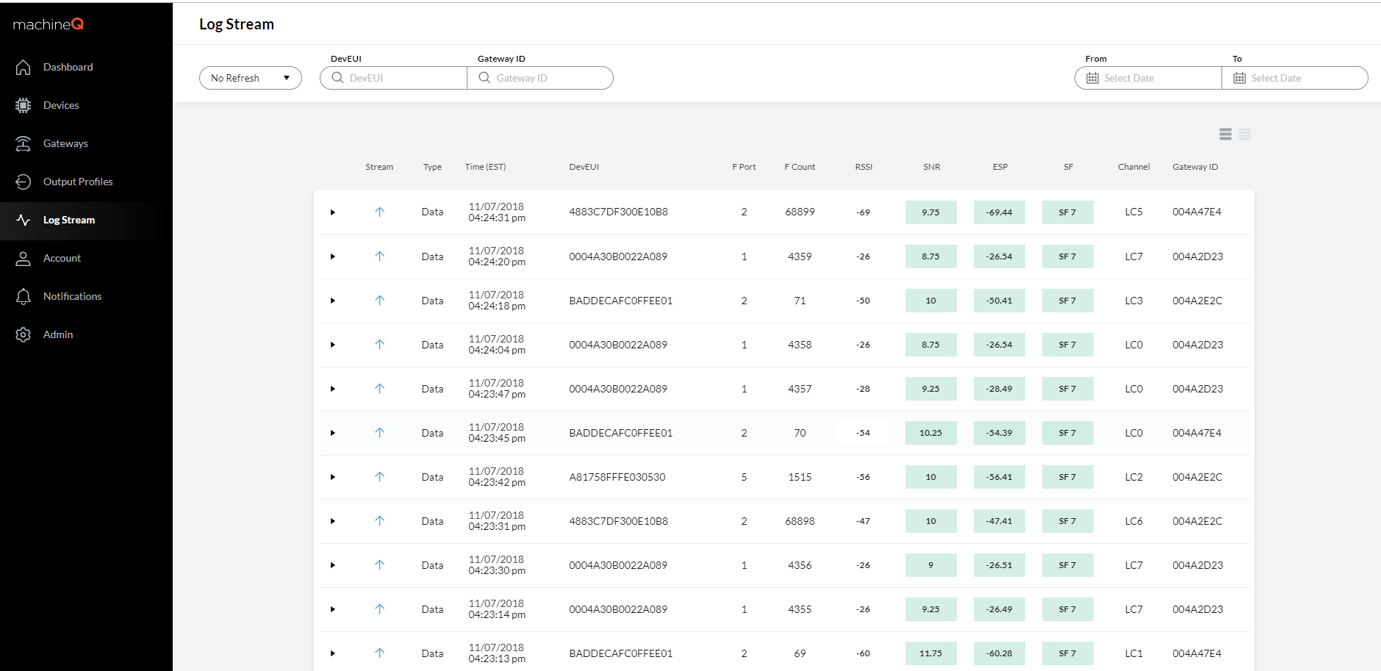
Test
2. Go to mQ Central -> Wireless Logger to confirm the reception of the uplink messages

Slide 12
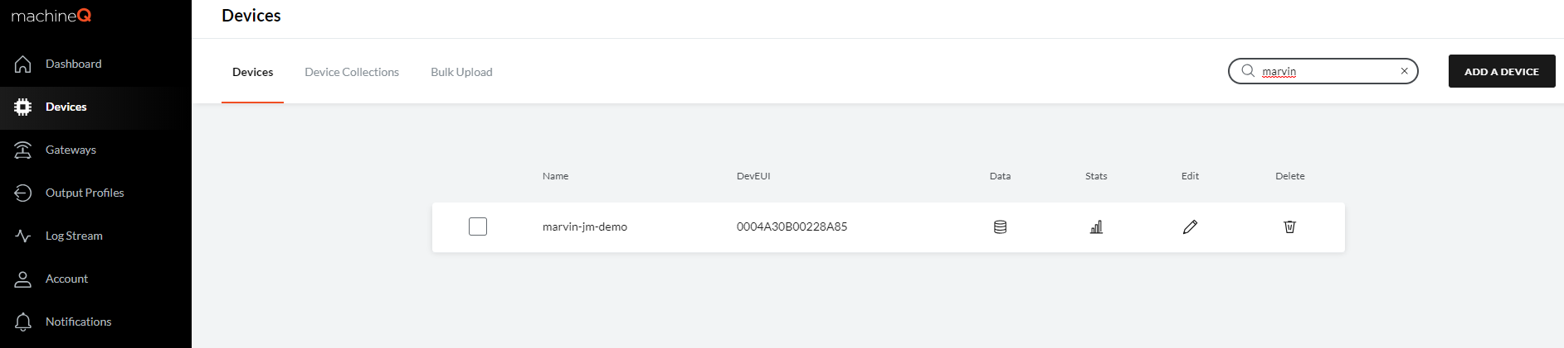
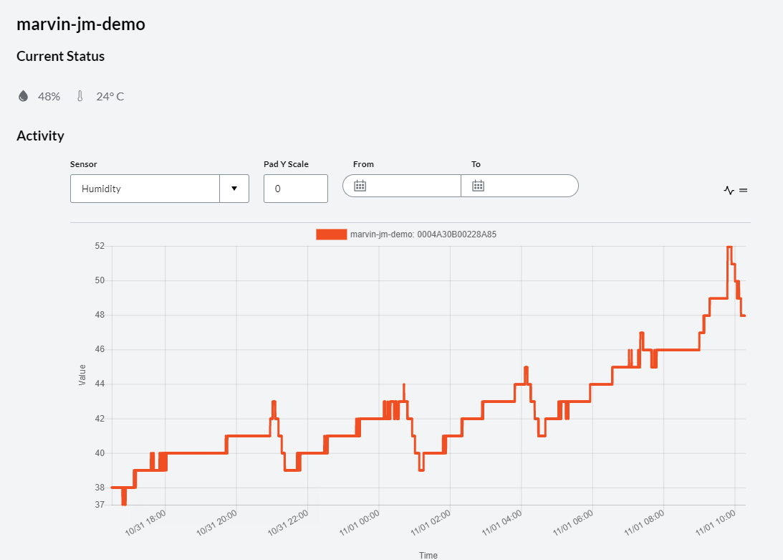
Test
3. Visualize the data on mQ Central…. Go to Devices -> click on your device -> Data
1
2

